Slide 1
Intro to Natural Language Processing (NLP)
Fiammetta Caccavale
Original Slides: 2021
Revisited: Nov 2025

Slide 2
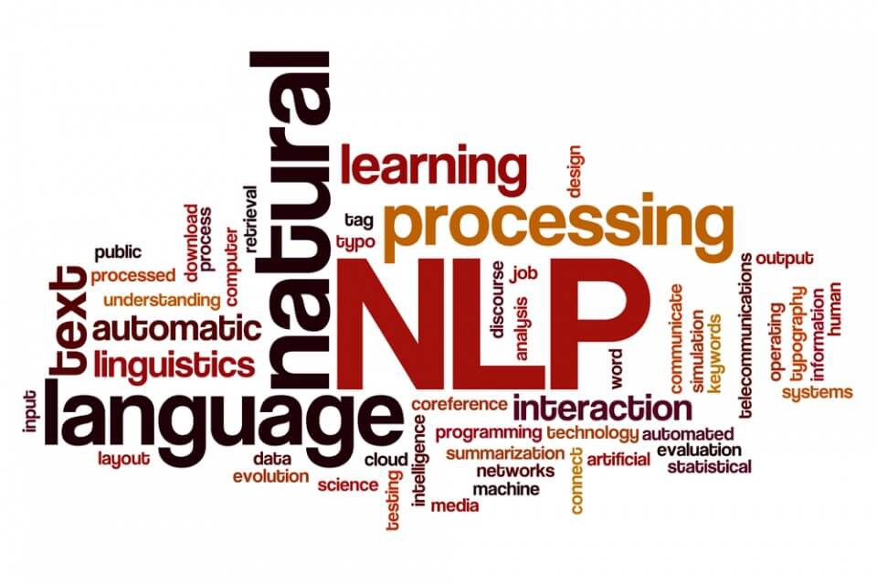
Natural Language Processing (NLP)
Subfield of linguistics, computer science and artificial intelligence
Interactions between computers and language
Analysing and learning from natural language data

Slide 3
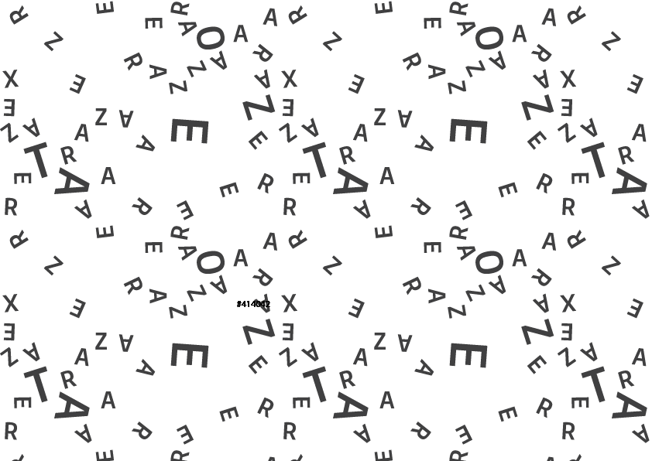
Why is it relevant?
Text is everywhere
Notes:
Image from: https://www.textrazor.com/

Slide 4
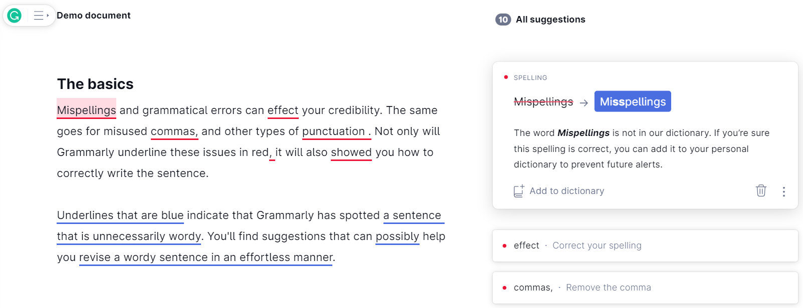
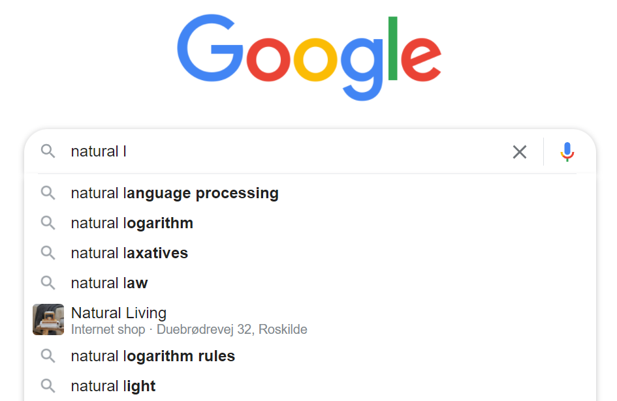

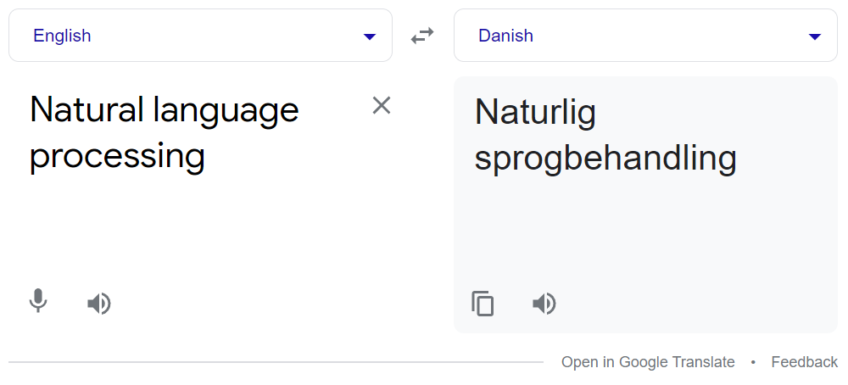
Applications of NLP
Grammar check
Autocomplete, Q&A
Sentiment analysis
Machine translation
Notes:
Information retrieval
Sentiment analysis
Information extraction
Question answering
Machine Translation

Slide 5
Objective
Pre-process a raw sentence

Slide 6
Text Pre-processing
Raw sentence
“What a beautiful day to teach Natural Language Processing to students!”
“what a beautiful day to teach natural language processing to students!”
[‘what’, ‘a’, ‘beautiful’, ‘day’, ‘to’, ‘teach’, ‘natural’, ‘language’, ‘processing’, ‘to’, ‘students’, ‘!’]
['what', 'a', 'beautiful', 'day', 'to', 'teach', 'natural', 'language', 'processing', 'to', 'students']
['beautiful', 'day', 'teach', 'natural', 'language', 'processing', 'students']
['beautiful', 'day', 'teach', 'natural', 'language', 'processing', 'student']
['beauti', 'day', 'teach', 'natur', 'languag', 'process', 'student']
Lowercasing
Tokenization
Punctuation removal
Stop words removal
Lemmatization
What’s the difference between lemmatizing and stemming? When is lemmatizing preferable?
Stemming
Notes:
Lemmatization: The task of removing inflectional endings only and to return the base dictionary form of a word which is also known as a lemma. Lemmatization is another technique for reducing words to their normalized form.
Stemming: The process of reducing inflected (or sometimes derived) words to a base form (e.g., "close" will be the root for "closed", "closing", "close", "closer" etc.). Stemming yields similar results as lemmatization, but does so on grounds of rules, not a dictionary.
Stemming: It is a process of transforming a word to its root form.
Lemmatization: Unlike stemming, lemmatization reduces the words to a word existing in the language.
Lemmatization is preferred over Stemming because lemmatization does a morphological analysis of the words.

Slide 7
Pre-processing Exercise – 2 minutes
Pre-process the text:
“Right now, I am processing a sentence”
Remember to include:
Lowercasing
Tokenization
Punctuation removal
Stop words removal
Lemmatization
Stemming

Slide 8
Checking the exercise
Raw sentence
Right now, I am processing a sentence
right now, i am processing a sentence
['right', 'now', ',', 'i', 'am', 'processing', 'a', 'sentence']
['right', 'now', 'i', 'am', 'processing', 'a', 'sentence']
['right', 'processing', 'sentence']
['right', 'processing', 'sentence']
['right', 'process', 'sentenc']
Lowercasing
Tokenization
Punctuation removal
Stop words removal
Lemmatization
Stemming

Slide 9
Objective
Solve word analogies

Slide 10
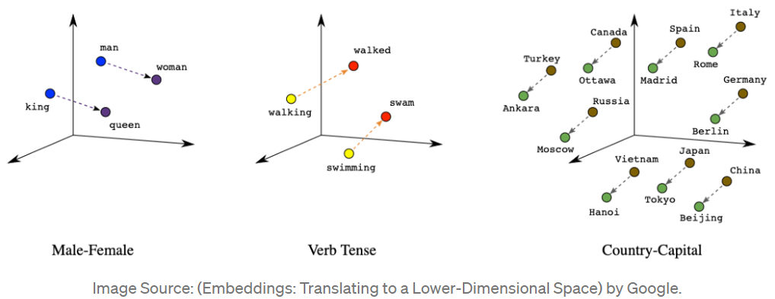
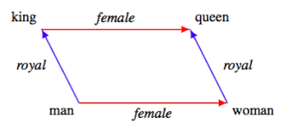
Word Analogies
Mikolov, et al., 2013, Linguistic regularities in continuous space word representations.
Mikolov et al., 2013, Distributed Representations of Words and Phrases
Image: https://developers.google.com
Notes:
Image: https://developers.google.com

Slide 11
We find that these representations are surprisingly good at capturing syntactic and semantic regularities in language, and that each relationship is characterized by a relation-specific vector offset. This allows vector-oriented reasoning based on the offsets between words. For example, the male/female relationship is automatically learned, and with the induced vector representations, “King – Man + Woman” results in a vector very close to “Queen.”
- Mikolov, T., Yih, W.T. and Zweig, G., 2013, June. Linguistic regularities in continuous space word representations. In Proceedings of the 2013 conference of the north american chapter of the association for computational linguistics: Human language technologies (pp. 746-751).

Slide 12
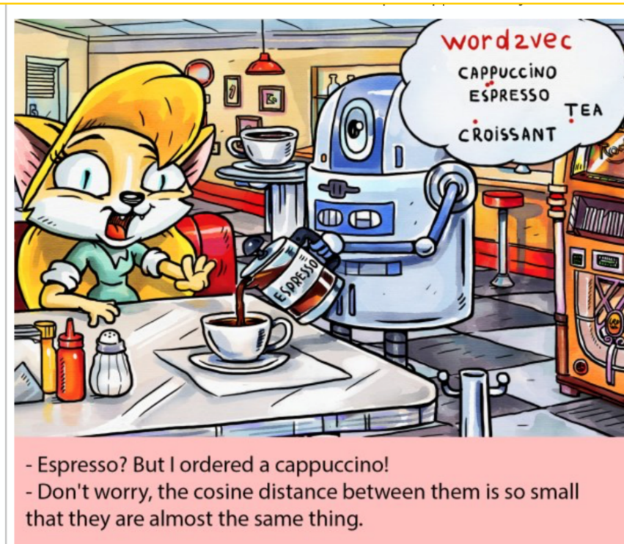
Word Vectors
Representation of words in the form of a real-valued vector.
Vector encodes the meaning of the word - the words that are closer in the vector space are expected to be similar in meaning.
Multiple methods to generate this mapping (e.g. neural networks, dimensionality reduction on the word co-occurrence matrix, probabilistic models).
Notes:
explainable knowledge base method, and explicit representation in terms of the context in which words appear
https://www.google.com/search?q=natural+language+processing+memes+cappuccino&tbm=isch&ved=2ahUKEwimuJCjrtT0AhUHxCoKHRSRCUQQ2-cCegQIABAA&oq=natural+language+processing+memes+cappuccino&gs_lcp=CgNpbWcQAzoFCAAQgAQ6BAgAEB5Q3xVYqyhg5y1oAHAAeACAAYcBiAG-CJIBAzkuM5gBAKABAaoBC2d3cy13aXotaW1nwAEB&sclient=img&ei=JbqwYeaRNIeIqwGUoqagBA&bih=577&biw=1280&rlz=1C1GCEA_enDK978DK978#imgrc=gmT3u0634CfaTM

Slide 13
Word Embedding Exercise
Mikolov, et al., 2013, Linguistic regularities in continuous space word representations.
Mikolov et al., 2013, Distributed Representations of Words and Phrases
Image: https://developers.google.com

Slide 14
Objective
Identify more real world applications of NLP

Slide 15
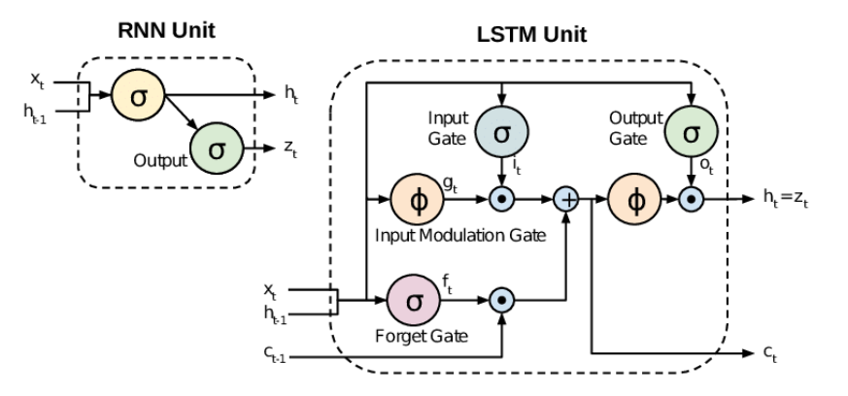
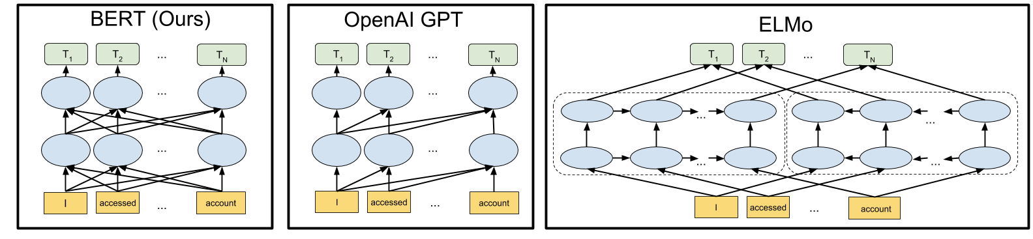
Neural Networks in NLP
Notes:
https://www.google.com/search?q=neural+networks+in+nlp&rlz=1C1GCEA_enDK978DK978&source=lnms&tbm=isch&sa=X&ved=2ahUKEwib5ZCn5tT0AhUdR_EDHQo_Bv0Q_AUoAXoECAIQAw&biw=1280&bih=577&dpr=1.5#imgrc=azhCIJ5quS0PXM
https://www.google.com/search?q=neural+networks+in+nlp&tbm=isch&chips=q:neural+networks+in+nlp,online_chips:lstm:uVuiSHMkIbE%3D&rlz=1C1GCEA_enDK978DK978&hl=en-US&sa=X&ved=2ahUKEwiW1M6v5tT0AhVslosKHciHDpkQ4lYoAXoECAEQEw&biw=1263&bih=577#imgrc=a6ggzARLg3LNXM

Slide 16

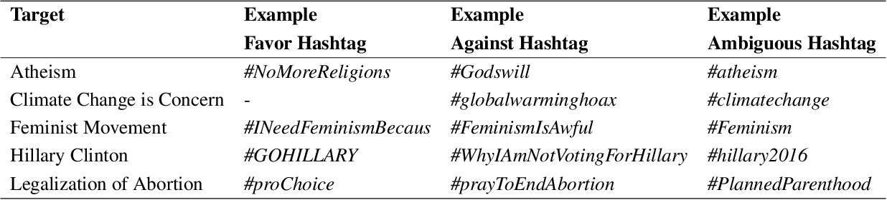

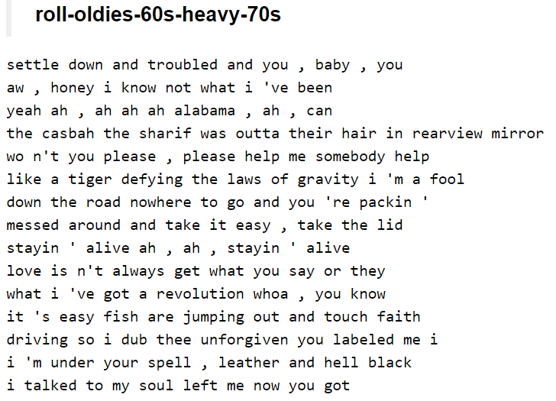
More examples of applications
Chatbots
Stance detection
Speech recognition
Text generation
Notes:
https://www.google.com/search?q=stance+analysis&rlz=1C1GCEA_enDK978DK978&sxsrf=AOaemvKvRkcYiWq0O5LDsWHMG1UOSKLzsg:1638975717098&source=lnms&tbm=isch&sa=X&ved=2ahUKEwjtsqarvNT0AhWCSfEDHRaEApcQ_AUoAXoECAEQAw&biw=1280&bih=577&dpr=1.5#imgrc=BpBCL2FCzm3qkM
https://socialgraphs.wordpress.com/
https://www.google.com/search?q=chatbots&rlz=1C1GCEA_enDK978DK978&sxsrf=AOaemvKvlPa_e4bRolEP3Nlcp_sWZcF8zA:1638976182414&source=lnms&tbm=isch&sa=X&ved=2ahUKEwjdg5eJvtT0AhXlQvEDHULSAH0Q_AUoAXoECAIQAw&biw=1280&bih=577&dpr=1.5#imgrc=lWMBrRXcrt4uzM
https://www.google.com/search?q=speech+recognition&rlz=1C1GCEA_enDK978DK978&sxsrf=AOaemvIhqNwFs-XE6_N8bAlfYmT0BD3uLQ:1638976253842&source=lnms&tbm=isch&sa=X&ved=2ahUKEwiD156rvtT0AhXZS_EDHcCXDTUQ_AUoAXoECAIQAw&biw=1280&bih=577&dpr=1.5#imgrc=GsBJ7Qqup6__LM

Slide 17
Working with Text in 2025: Large Language Models (LLMs)

Slide 18
The rise of generative AI
A big shift in NLP research was observed in 2017, when the Transformer architecture [1] was first released.
Since then, models have been continuously improving, reaching milestones almost unforeseen.
In November 2022, a generative AI chatbot, ChatGPT, was released by OpenAI. The AI assistant was powered by a large language model (of the GPT series).
[1] Vaswani, A., Shazeer, N., Parmar, N., Uszkoreit, J., Jones, L., Gomez, A. N., ... & Polosukhin, I. (2017). Attention is all you need. Advances in neural information processing systems, 30.

Slide 19
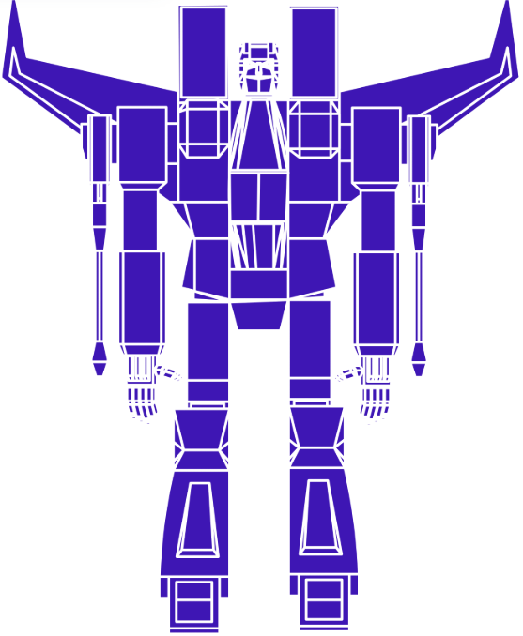
Transformer models
All current LLMs powering AI assistants are based on one architecture: the Transformer

Slide 20
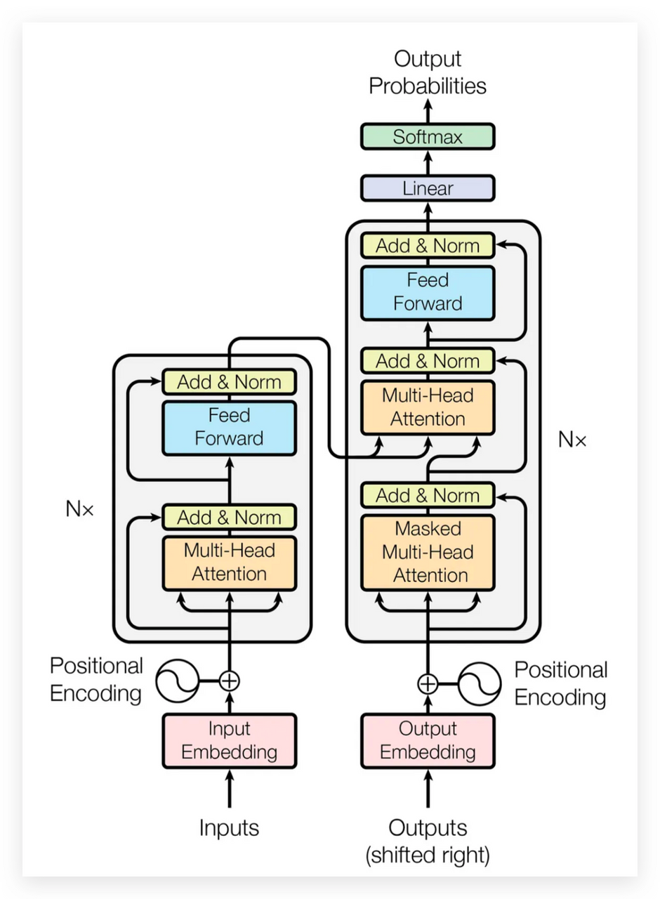
Transformer models
All current LLMs powering AI assistants are based on one architecture: the Transformer
Vaswani, A., Shazeer, N., Parmar, N., Uszkoreit, J., Jones, L., Gomez, A. N., ... & Polosukhin, I. (2017). Attention is all you need. Advances in neural information processing systems, 30.

Slide 21
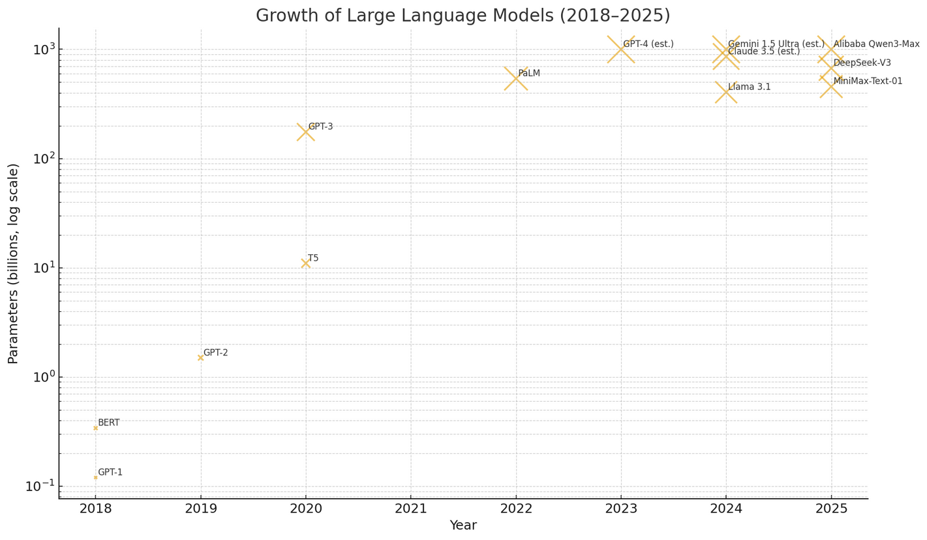
Large Language Models
LLMs power the virtual assistants that we commonly use nowadays
They are trained of massive amount of data

Slide 22
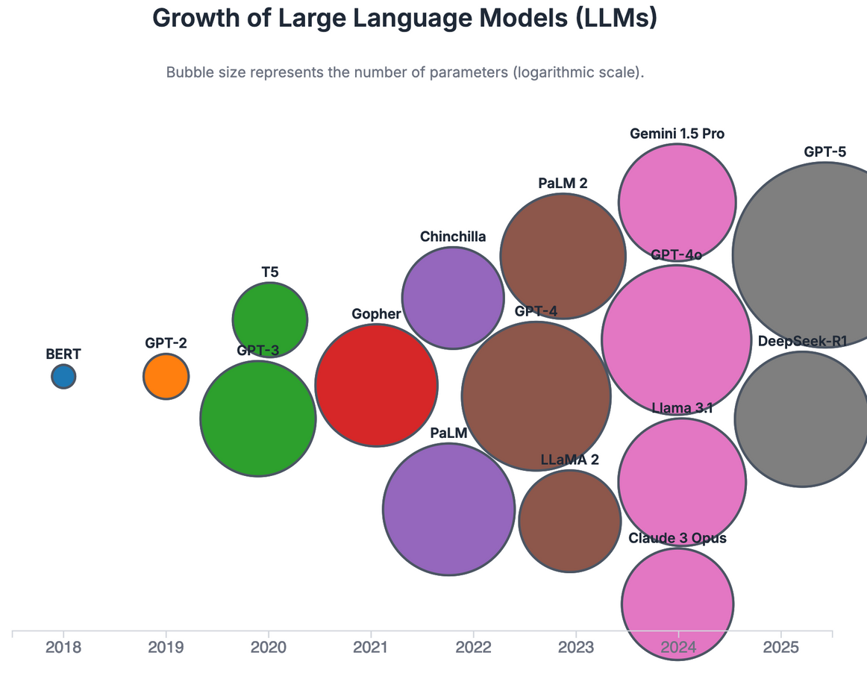
Large Language Models
LLMs power the virtual assistants that we commonly use nowadays
They are trained of massive amount of data

Slide 23
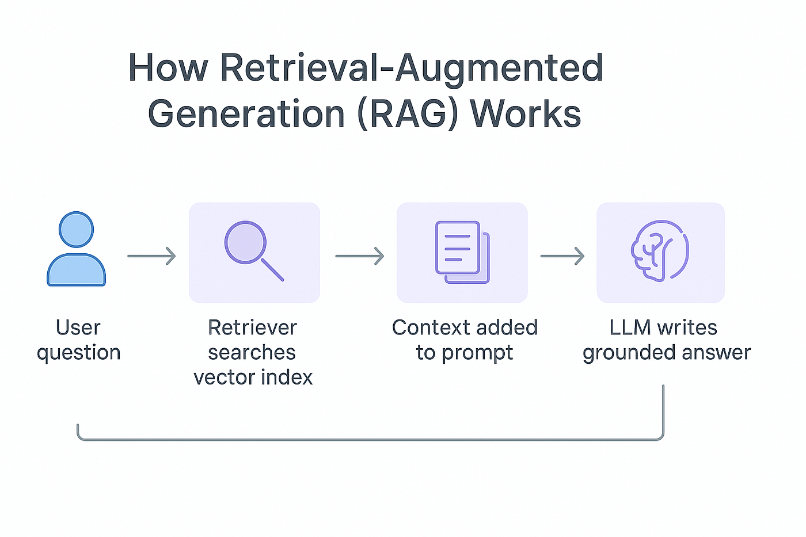
Retrieval augmented generation (RAG)
In order to constraint LLMs, limiting hallucinations and injecting domain knowledge, RAG systems have been explored.
https://medium.com/@vanshika.kaushik_48069/retrieval-augmented-generation-rag-explained-069131c7dfc0

